Slide 1
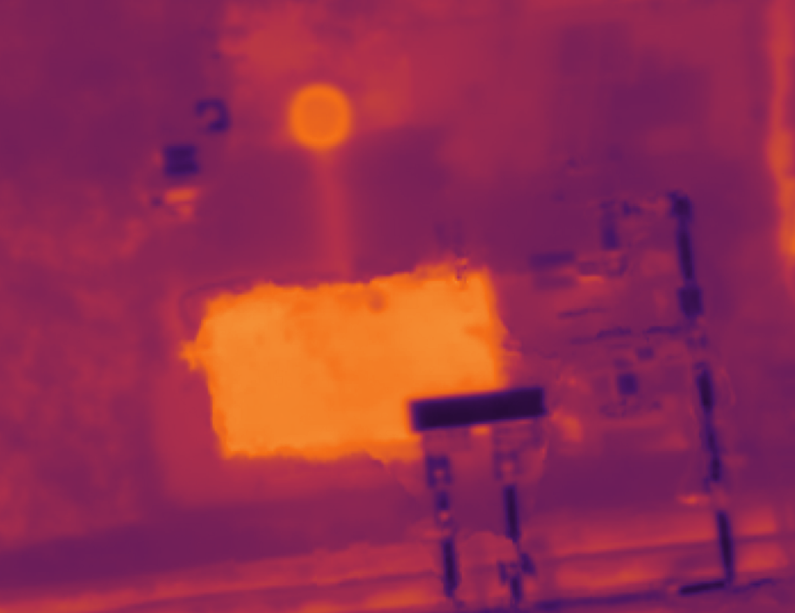
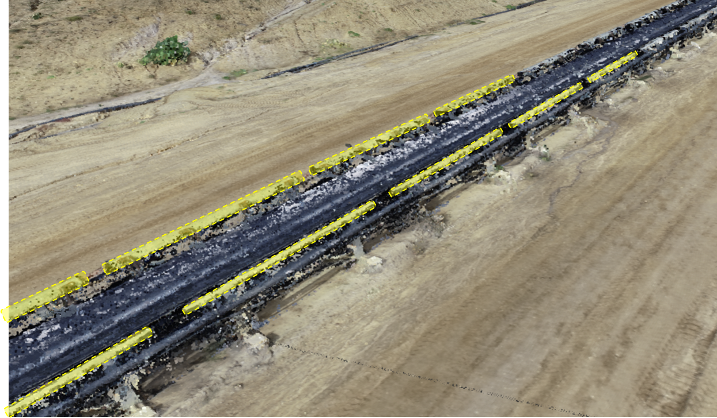
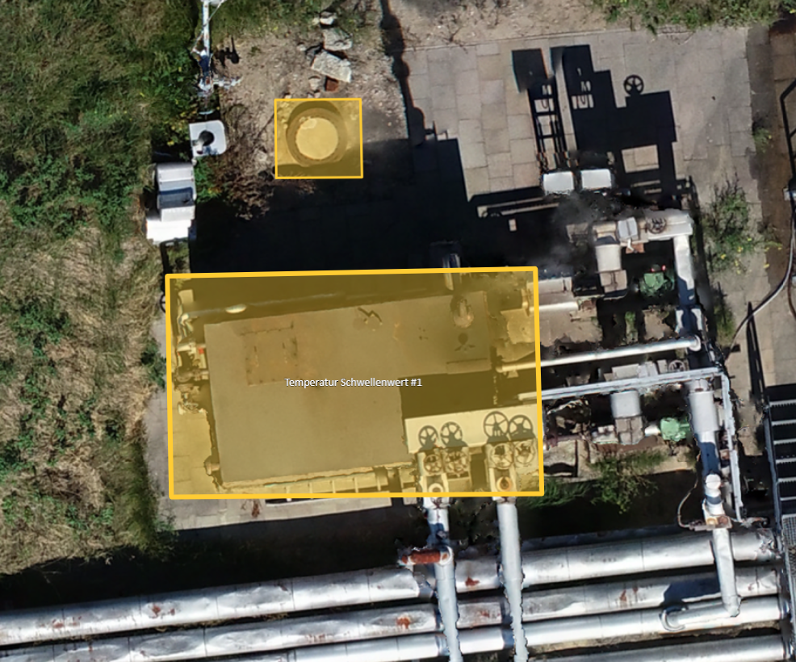
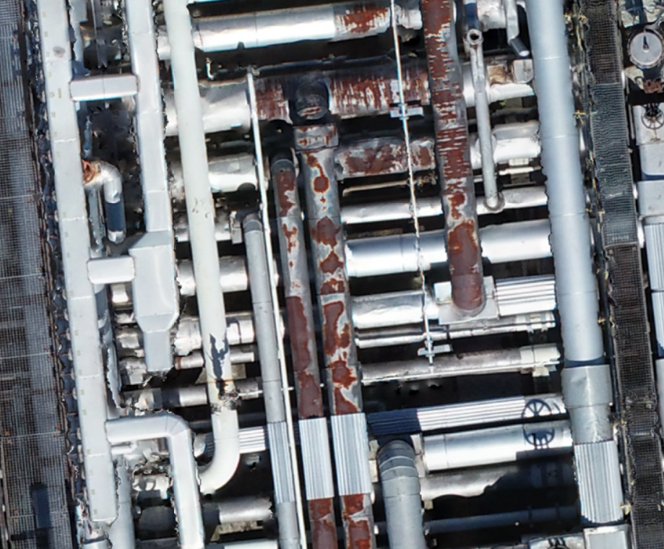
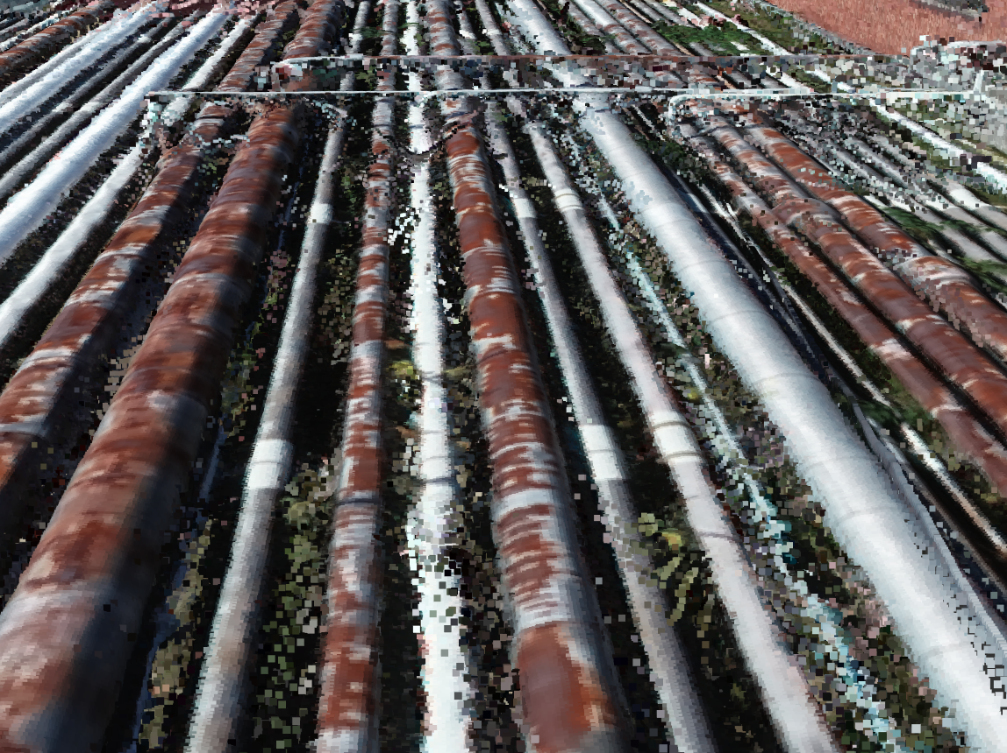
ACTEMIUM USE CASES, TECHNOLOGY SOLUTIONS & REQUIRED EFFORT
Conveyor Belt Deformation Detection
Temperature Loss Detection
Rust Detection
Pipe 2D alignments or 3D modeling
Same 2D base technology
Multiview Segmentation
2D Image Segmentation
2D Image Segmentation
Multiview Segmentation
Image labeling
20.000 € invest in labeling per use case, raw data must be available
5 Schicht Betrieb, 2 Personen
Stillstand kostet viel (halber Tag, mehrere 20.000 €)
5k€ pro Stunde Verlust, Tagebau, Kohle
or
or
3D technology
3D Segmentation
3D Segmentation
3D
Multiview Segmentation
2D Image Segmentation
Software solution around it
=
+

Slide 2
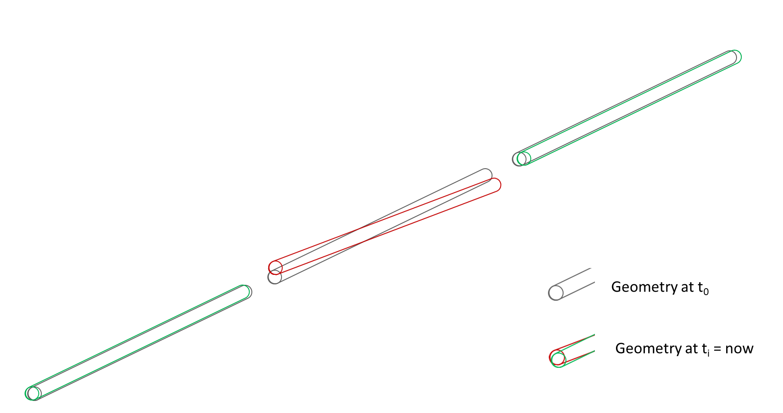
Update Actemium Use case: Conveyer belt deformation detection

Slide 3
General Context
# Recognize and isolate individual parts of a conveyer belt via semantic segmentation
# compare the general geometry of the critical parts on several consecutive scans over time to find deformations
Create RGB Point Cloud from the conveyer belt using Drone images
Isolate critical components in Point Cloud via Virtual Multiview Segmentation
Fit approximated 3D Shapes to the point clusters
Compare orientation of 3D shapes at t_{i} to original orientation at t₀
(will be validated in a last meeting with Erich on thursday)

Slide 4
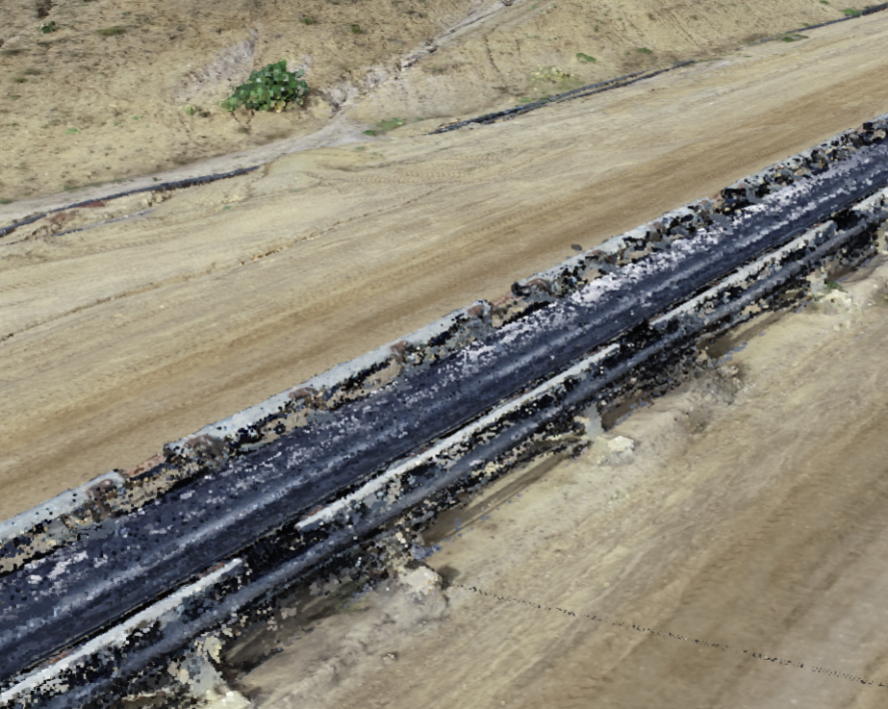
1.) Isolate specific components via Multiview Segmentation

Slide 5
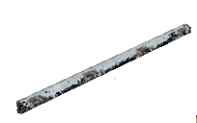
2.) Fit approximated 3D CAD geometry to the isolated point clusters (e.g. using optimization)

Slide 6
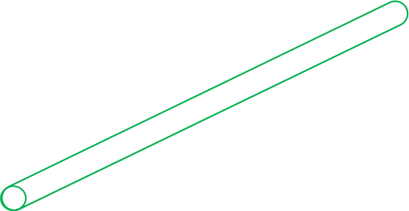
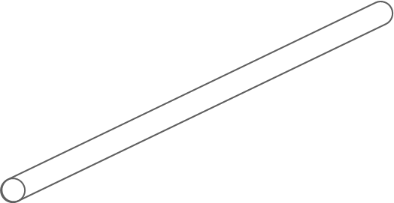
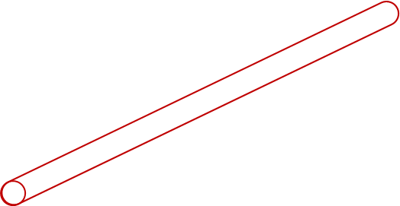
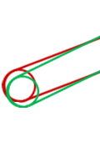
2.) Detect e.g. critical deformations by comparing the current 3D CAD representation of the components to the original geometry derived at t = 0.
Geometry at t₀
Geometry at t_{i} = now

Slide 7
Object segmentation in RGB Point Clouds using Virtual Multiview Segmentation Mini-POC

Slide 8
Virtual Multiview Segmentation
Basic Concept
a „virtual camera“ takes multiple „snapshots“ of a (meshed) Point Cloud in a suitable Point Cloud / CAD Software
For each snapshot:
position, angle and field of view of the virtual camera are known
From there, infinite rays that correspond with the “light rays” received by the virtual camera are computed
Those rays are intersected with the 3D geometry
The intersection events are used to project the result of the 2D image segmentation of the snapshot onto the original 3D geometry
Each point collects “class-votes” from multiple segmented snapshots
The final class of a point is computed using the majority principle

Slide 9
Virtual Multiview Segmentation Mini-POC
Advantages
The actual Deepl Learing Process happens on 2D images
→ We can leverage pretrained image segmentation Networks
→ We can use well documented state of the art frameworks like PyTorch
We can use existing 2D labelling Tools, → no need for complicated, time-consuming labelling of 3D Pint clouds

Slide 10
Some literature review supporting the approach

Slide 11
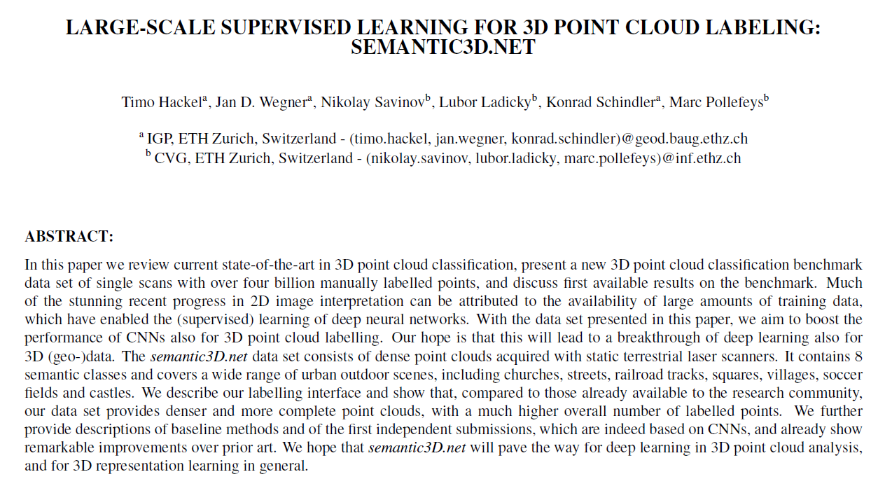
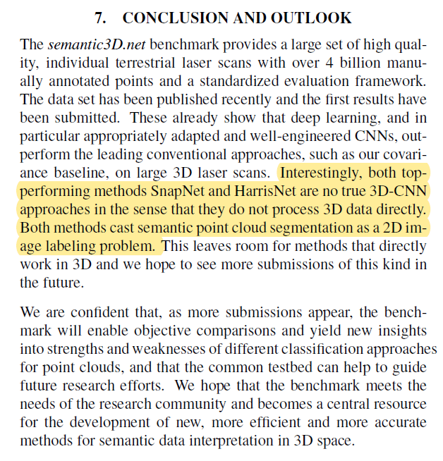
Paper (2019) by Microsoft # supporting the Multiview Segmentation Approach

Slide 12
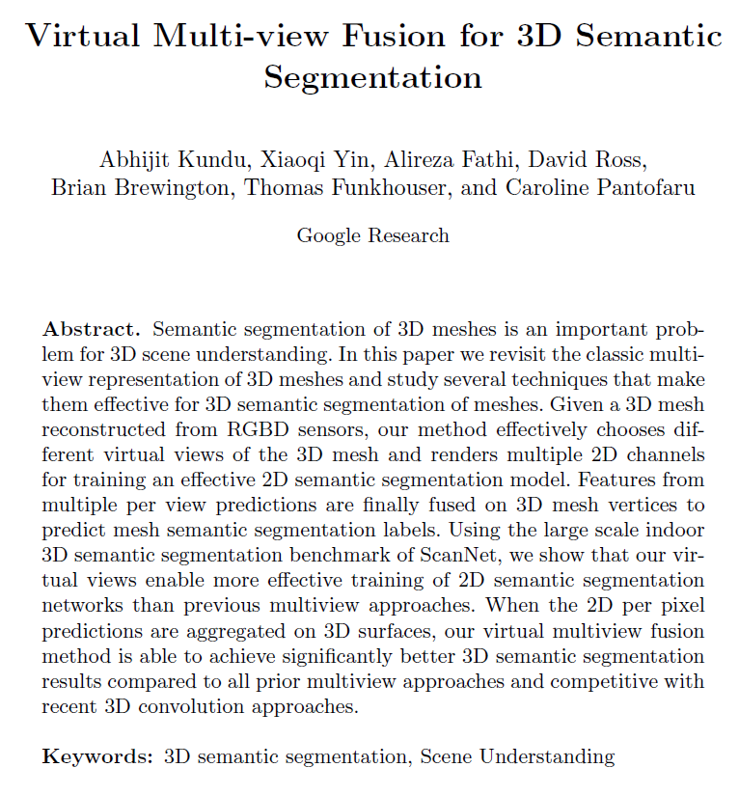
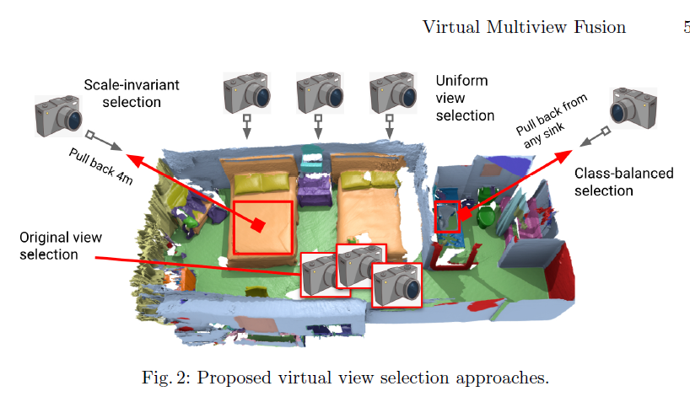
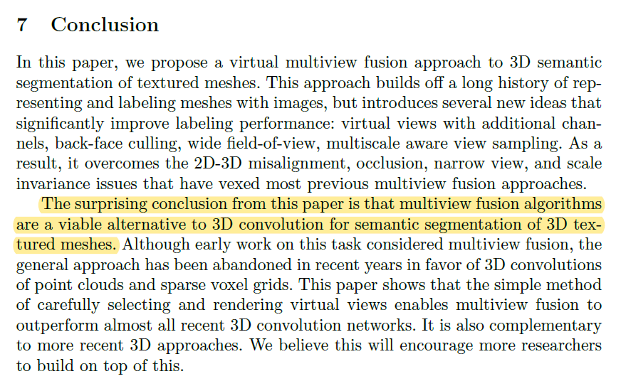
Paper (2020) by Google Research # supporting the Multiview Segmentation Approach

Slide 13
Sand-box tests conducted by VIA IMC

Slide 14
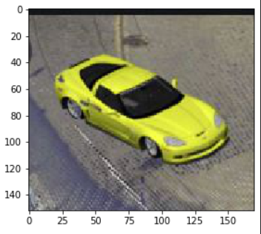
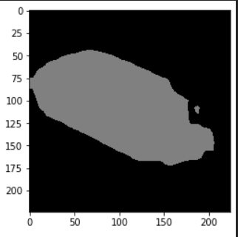
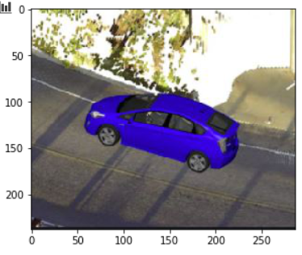
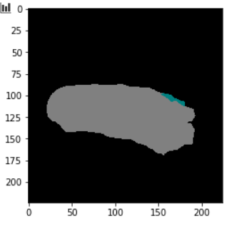
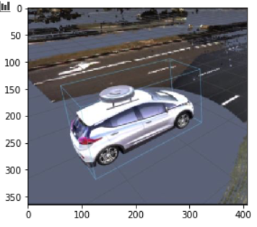
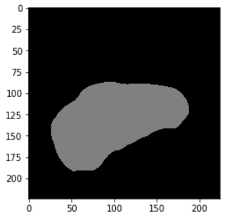
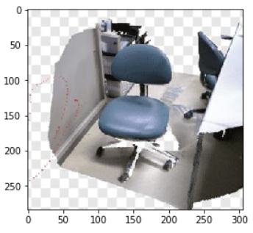
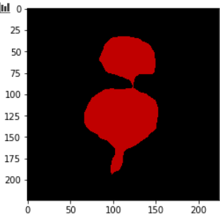
Test 1: Pretrained Image Segmentation Network recognize objects on Screenshots of 3D Point Cloud Scenes (Even though it was trained on real images) Tested using PyTorch with pretrained resnet101 back bone
# Leveradged model:
from torchvision import models
fcn = models.segmentation.fcn_resnet101(pretrained=True).eval()

Slide 15
Test 1: Pretrained Image Segmentation Network recognize objects on Screenshots of 3D Point Cloud Scenes (Even though it was trained on real images)
Why did we test this?
Although during the actual project, we will retrain train the last layers of a chosen image segmentation network to detected our use case specific objects (conveyer belt components), we wanted to check weather a network that was pretrained directly on the original images would also be able to detect objects in screenshots of rendered RGB point clouds
We assume that if the network is able to detect whole objects in those screenshots, the abstract features learned by the network during pretraining will also be valid when we retrain the last layers to recognize our usecase specific objects in virtual snapshots (using transfer learning)
Preliminary Results
If the resolution of rgb point cloud from which the snapshot is taken is good enough, it seems to make little to no difference compared to segmenting the “real” photo directly.
Whether we want to label “real” photos or virtual snapshots needs to be decided; so far it seems like both approaches would enable us to use the virtual multiview segmentation approach

Slide 16
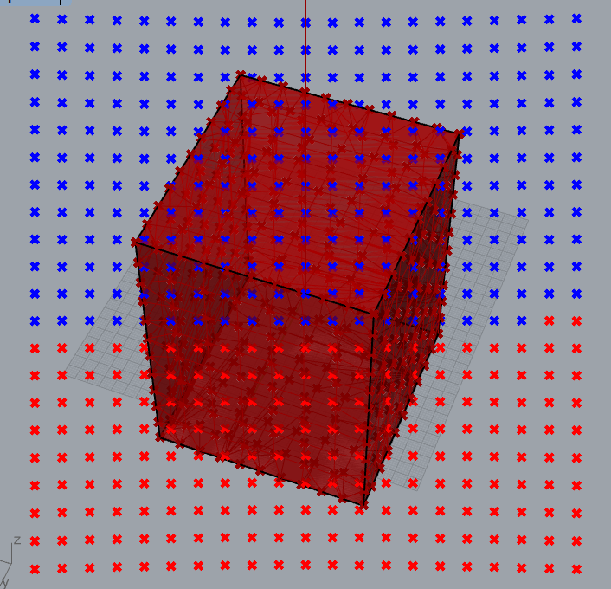
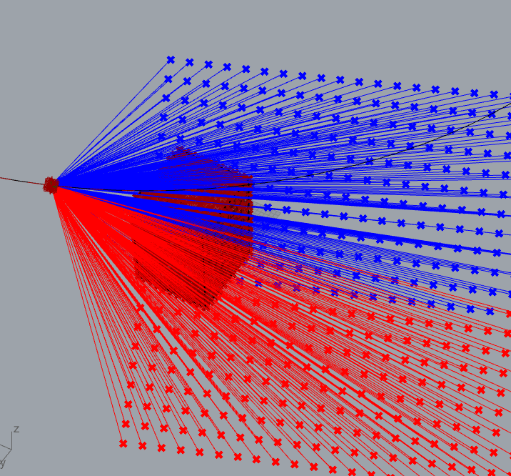
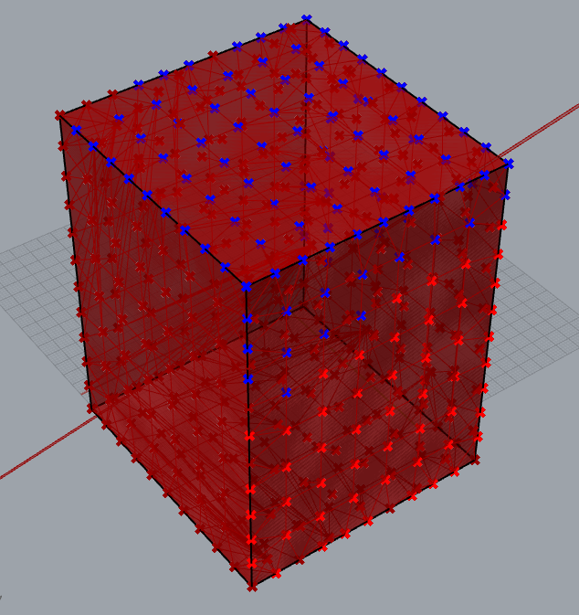
Test 2: Projecting the result of the segmentation of a virtual snapshot onto the original 3D geometry
The following slides demonstrate the concept using a naive prototype implemented by VIA IMC
Finding/developing a more performant tool will be part of the project

Slide 17
Some blue/red sample image (representing an actual pixel mask) # each dot corresponds with a pixel of the pixel-mask that represents the result of the image segmentation process (blue = lable_1, red = lable_2)
Legend:
= some pixel mask
= some 3D object (meshed point cloud)

Slide 18
# Each dot is actually an infinite ray, linked to the pixel color(/label) and the perspective of one specific image (or it‘s pixel mask, respectively) # The rays intersect with a mesh generated from the point

Slide 19
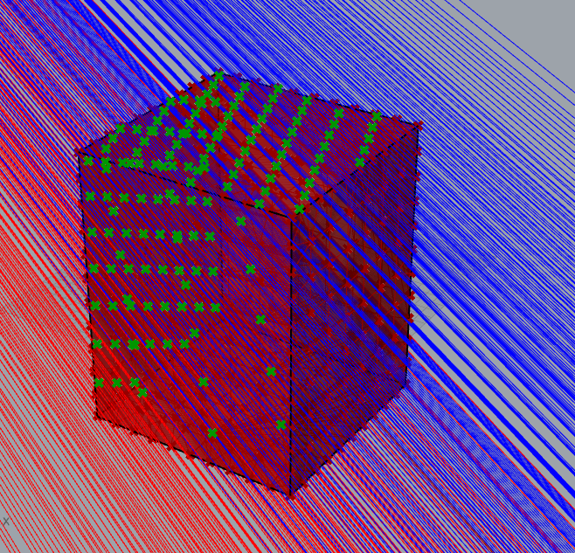
All intersection events between the rays and the 3D mesh are computed (the green dots)

Slide 20
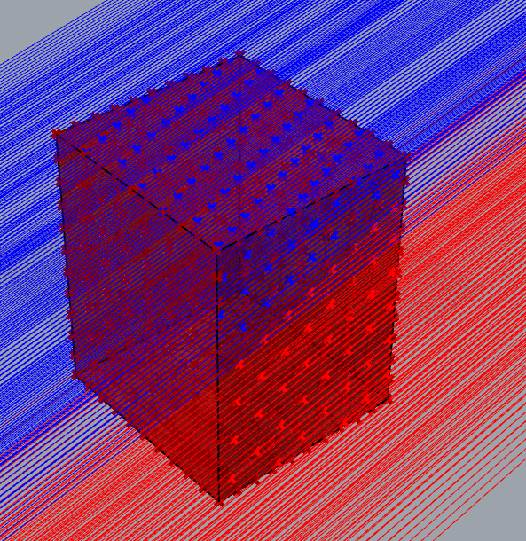
All intersection events are linked to the colors of the original rays (visualized via the blue and red dots)

Slide 21
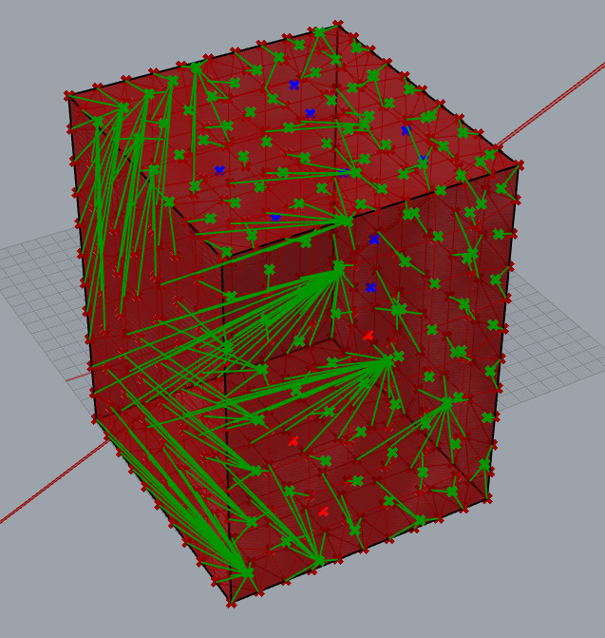
All mesh vertices (= points of the original point cloud) are linked to their neares mesh-ray-intersection event (visualized as green lines)

Slide 22
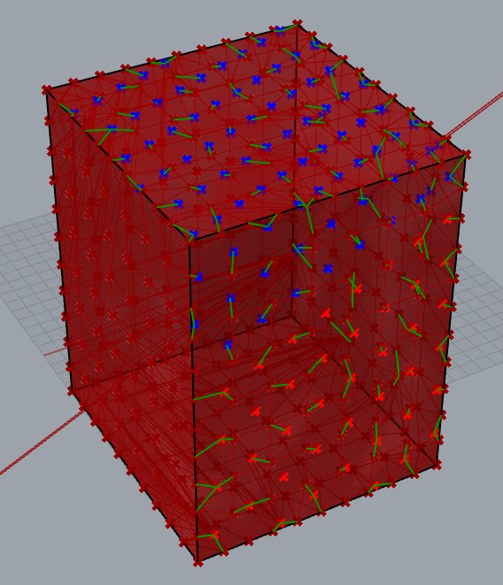
Mesh-Vertices are only linked to their nearest intersection-event if the distance is smaller than a certain threshold (only the short green lines remain) → This way we avoid linking the “backside” of the mesh geometry, which is not visible on the snapshot that was segmented

Slide 23
Finally, vertices are linked to the color (=label) of the nearest intersection event → The labels from the 2D snapshot are projected onto the 3D geometry (note: the “back side” of the geometry (left lower corner of this cube) is not labled during this snap shot)

Slide 24
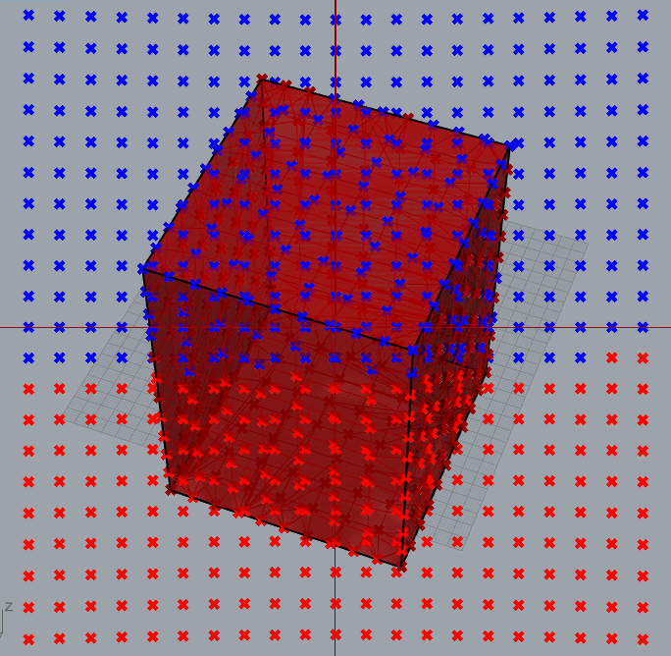
# We repeat this process for many “snapshots” of the 3D geometry # from each snapshot, a mesh vertex (= point cloud point) possibly collects a lable-vote # At the end, each vertex is linked with many (possibly different votes) # finally, a majority vote decides the actual label of the point

Slide 25
Discussion

Slide 26
